Slide 1

Introduction of Tuples
COMP 6502 + COMP 6056
By Ida Bagus Kerthyayana Manuaba
Monday, 28 Sep 2020

Slide 2
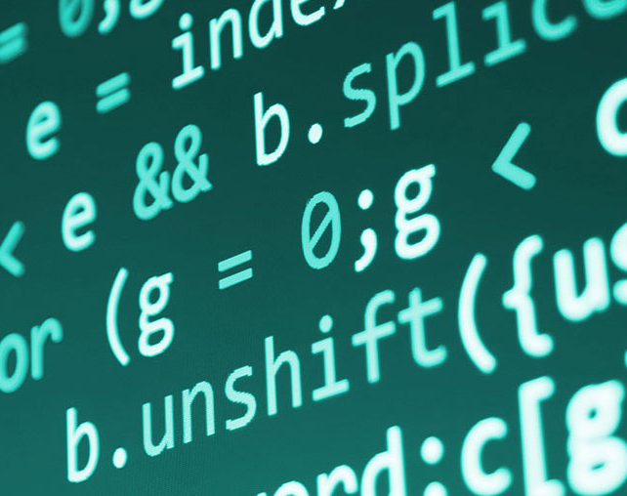
Agenda
Review:
Python List
String
Python Tuples

Slide 3
Learning Outcome
COMP 6502 - I2P:
Apply principles of Python programming in designing and developing a program
Translate a specified algorithm into correct self-documented Python code using generally accepted programming style.
Identify programming errors and solution requirements toward the problem
COMP 6506 - PDM:
Explain the basic principles of computing and programming
Design algorithmic solutions to problems.

Slide 4
Session Outcomes
Access elements in a list
Change, add and remove elements in a list
Organize a list
use pseudo code and flow chart to design simple programs that read input
write simple code to perform mathematical operations
produce screen output

Slide 5
Review:
Python Lists

Slide 6
Python List
Six Characteristics of List and Examples

Slide 7
String
What you have learn about “String” data type

Slide 8

Python Tuples
Collection Data Type

Slide 9

Collection Data Types (Arrays)
Python List is a member of collection data types in Python
There are 4 collection data types:
List
a collection which is ordered and changeable.
Allows duplicate members.
Tuple
a collection which is ordered and unchangeable.
Allows duplicate members.
Set
a collection which is unordered and unindexed.
No duplicate members
Dictionary
a collection which is unordered, changeable and indexed.
No duplicate members.

Slide 10
Python Tuples
A Tuple is a collection of Python objects separated by commas.
In someway a tuple is similar to a List in terms of indexing, nested objects and repetition but a tuple is immutable unlike lists which are mutable.

Slide 11
The characteristics of Python Tuples
Tuples are defined in the same way as lists.
They are enclosed within parenthesis and not within square braces.
Elements of the tuple must have a defined order.
Negative indices are counted from the end of the tuple, just like lists.
Tuple also has the same structure where commas separate the values.

Slide 12

Creating a Tuple
A tuple is created by placing all the items (elements) inside parentheses (), separated by commas.
The parentheses are optional; however, it is a good practice to use them.
A tuple can have any number of items and they may be of different types (integer, float, list, string, etc.).

Slide 13
# Different types of tuples
# Empty tuple
my_tuple = ()
print(my_tuple)
# Tuple having integers
my_tuple = (1, 2, 3)
print(my_tuple)
# tuple with mixed datatypes
my_tuple = (1, "Hello", 3.4)
print(my_tuple)
# nested tuple
my_tuple = ("mouse", [8, 4, 6], (1, 2, 3))
print(my_tuple)
Output ?

Slide 14
Output:
()
(1, 2, 3)
(1, 'Hello', 3.4)
('mouse', [8, 4, 6], (1, 2, 3))

Slide 15
A tuple can also be created without using parentheses. This is known as tuple packing.
my_tuple = 3, 4.6, "dog"
print(my_tuple)
# tuple unpacking is also possible
a, b, c = my_tuple
print(a) # 3
print(b) # 4.6
print(c) # dog

Slide 16
Creating a tuple with one element is a bit tricky.
Having one element within parentheses is not enough. We will need a trailing comma to indicate that it is, in fact, a tuple.
my_tuple = ("hello")
print(type(my_tuple)) # <class 'str’>
# Creating a tuple having one element my_tuple = ("hello",)
print(type(my_tuple)) # <class 'tuple’>
# Parentheses is optional
my_tuple = "hello",
print(type(my_tuple)) # <class 'tuple’>

Slide 17

Access Tuple Elements
There are various ways in which we can access the elements of a tuple.
Indexing
Negative Indexing
Slicing

Slide 18
Indexing
We can use the index operator [] to access an item in a tuple, where the index starts from 0.
So, a tuple having 6 elements will have indices from 0 to 5. Trying to access an index outside of the tuple index range(6,7,... in this example) will raise an IndexError.
The index must be an integer, so we cannot use float or other types. This will result in TypeError.
Likewise, nested tuples are accessed using nested indexing

Slide 19
Examples:
# Accessing tuple elements using indexing
my_tuple = ('p','e','r','m','i','t’)
print(my_tuple[0]) # 'p’
print(my_tuple[5]) # 't’
# IndexError: list index out of range
# print(my_tuple[6])
# Index must be an integer
# TypeError: list indices must be integers, not float
# my_tuple[2.0]
# nested tuple
n_tuple = ("mouse", [8, 4, 6], (1, 2, 3))
# nested index
print(n_tuple[0][3]) # 's’
print(n_tuple[1][1]) # 4

Slide 20
Negative Indexing
Python allows negative indexing for its sequences.
Similar to ”List” The index of -1 refers to the last item, -2 to the second last item and so on.
# Negative indexing for accessing tuple elements
my_tuple = ('p', 'e', 'r', 'm', 'i', 't’)
# Output: 't’
print(my_tuple[-1])
# Output: 'p’
print(my_tuple[-6])

Slide 21
Slicing
Similar to List, We can access a range of items in a tuple by using the slicing operator colon :
# Accessing tuple elements using slicing
my_tuple = ('p','r','o','g','r','a','m','i','z’)
# elements 2nd to 4th
# Output: ('r', 'o', 'g’)
print(my_tuple[1:4])
# elements beginning to 2nd
# Output: ('p', 'r’)
print(my_tuple[:-7])
# elements 8th to end
# Output: ('i', 'z’)
print(my_tuple[7:])
# elements beginning to end
# Output: ('p', 'r', 'o', 'g', 'r', 'a', 'm', 'i', 'z’)
print(my_tuple[:])

Slide 22

Changing a Tuple
Unlike lists, tuples are immutable.
This means that elements of a tuple cannot be changed once they have been assigned. But, if the element is itself a mutable data type like list, its nested items can be changed.
We can also assign a tuple to different values (reassignment).

Slide 23
Examples:
# Changing tuple values
my_tuple = (4, 2, 3, [6, 5])
# TypeError: 'tuple' object does not support item assignment
# my_tuple[1] = 9
# However, item of mutable element can be changed
my_tuple[3][0] = 9 # Output: (4, 2, 3, [9, 5])
print(my_tuple)
# Tuples can be reassigned
my_tuple = ('p', 'r', 'o', 'g', 'r', 'a', 'm', 'i', 'z') # Output: ('p', 'r', 'o', 'g', 'r', 'a', 'm', 'i', 'z’)
print(my_tuple)
Output:
(4, 2, 3, [9, 5])
('p', 'r', 'o', 'g', 'r', 'a', 'm', 'i', 'z')

Slide 24
We can use + operator to combine two tuples. This is called concatenation.
We can also repeat the elements in a tuple for a given number of times using the * operator.
Both + and * operations result in a new tuple.
# Concatenation
# Output: (1, 2, 3, 4, 5, 6)
print((1, 2, 3) + (4, 5, 6))
# Repeat
# Output: ('Repeat', 'Repeat', 'Repeat’)
print(("Repeat",) * 3)

Slide 25

Deleting a Tuple
As discussed above, we cannot change the elements in a tuple. It means that we cannot delete or remove items from a tuple.
Deleting a tuple entirely, however, is possible using the keyword del.

Slide 26
Examples:
# Deleting tuples
my_tuple = ('p', 'r', 'o', 'g', 'r', 'a', 'm', 'i', 'z’)
# can't delete items
# TypeError: 'tuple' object doesn't support item deletion
# del my_tuple[3]
# Can delete an entire tuple
del my_tuple
# NameError: name 'my_tuple' is not defined
print(my_tuple)

Slide 27
Built-in Tuples Function and Method

Slide 28
Tuple Functions
Unlike Python lists, tuples does not have methods such as append(), remove(), extend(), insert() and pop() due to its immutable nature. However, there are many other built-in methods to work with tuples:
count() returns the number of occurrences of an item in a tuple.
len() function, you can return the length of the tuple
any() to discover whether any element of a tuple is an iterable. You'll get back True if this is the case, else it will return False.
tuple() to converts a data type to tuple. For example, in the code chunk below, you convert a Python list to a tuple.
While max() returns the largest element in the tuple, you can use min() to return the smallest element of the tuple.
sum(), with this function, you return the total sum of the items in a tuple. This can only be used with numerical values.
sorted(), to return a tuple with the elements in a sorted order

Slide 29
Tuple Methods
Methods that add items or remove items are not available with tuple. Only the following two methods are available.
Some examples of Python tuple methods:
Python Tuple count()
returns count of the element in the tuple
Python Tuple index()
returns the index of the element in the tuple
my_tuple = ('a', 'p', 'p', 'l', 'e’,)
print(my_tuple.count('p')) # Output: 2
print(my_tuple.index('l')) # Output: 3

Slide 30
Other Tuple Operations

Slide 31
1. Tuple Membership Test
We can test if an item exists in a tuple or not, using the keyword in.
# Membership test in tuple
my_tuple = ('a', 'p', 'p', 'l', 'e’,)
# In operation
print('a' in my_tuple) # True
print('b' in my_tuple) # False
# Not in operation
print('g' not in my_tuple) # True

Slide 32
2. Iterating Through a Tuple
We can use a for loop to iterate through each item in a tuple.
# Using a for loop to iterate through a tuple
for name in ('John', 'Kate’):
print("Hello", name)

Slide 33
3. Assigning Multiple Values
Something cool that you can do with tuples is to use them to assign multiple values at once.
a is a tuple of three elements and (one,two,three) is a tuple of three variables. Assigning (one,two,three) to a tuple assigns each of the values of a to each of the variables: one, two and three, in order. This can be handy when you have to assign a range of values to a sequence stored in a tuple.
a = (1,2,3)
(one,two,three) = a
print(one)

Slide 34
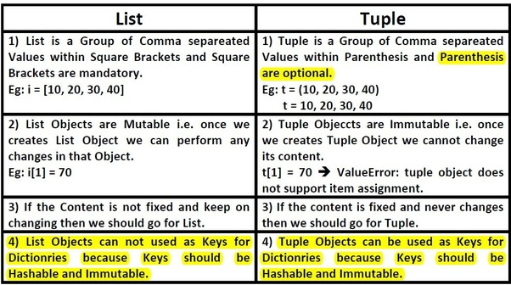
Lists vs Tuples

Slide 35
Advantages of Tuple over List
Since tuples are quite similar to lists, both of them are used in similar situations. However, there are certain advantages of implementing a tuple over a list. Below listed are some of the main advantages:
We generally use tuples for heterogeneous (different) data types and lists for homogeneous (similar) data types.
Since tuples are immutable, iterating through a tuple is faster than with list. So there is a slight performance boost.
Tuples that contain immutable elements can be used as a key for a dictionary. With lists, this is not possible.
If you have data that doesn't change, implementing it as tuple will guarantee that it remains write-protected.

Slide 36
So what we have learnt today?
Anyone?

Slide 37
References
https://www.programiz.com/python-programming/tuple
https://www.w3schools.com/python/python_tuples.asp
https://realpython.com/python-lists-tuples/#python-tuples
https://www.geeksforgeeks.org/tuples-in-python/
https://www.w3schools.in/python-tutorial/tuples/#:~:text=Some%20of%20the%20characteristics%20features,must%20have%20a%20defined%20order.
https://www.askpython.com/python/list/python-list-of-tuples
https://www.programiz.com/python-programming/methods/tuple
https://www.datacamp.com/community/tutorials/python-tuples-tutorial

Slide 38
Thank you

Slide 39
Still have Extra time?

Slide 40
Please use your Python Command Line for help
Copy your answer on Pedlet within 5 minutes https://padlet.com/imanuaba/tuplesExercises
Don’t forget to put your name in card title…

Slide 41
5 minutes Exercise
Exercise Question 1:
Reverse the following tuple
aTuple = (10, 20, 30, 40, 50)
Expected output:
(50, 40, 30, 20, 10)
Exercise Question 2:
Access value 20 from the following tuple
aTuple = ("Orange", [10, 20, 30], (5, 15, 25))
Expected output:
20

Slide 42
5 minutes Exercise
Exercise Question 1:
Reverse the following tuple
aTuple = (10, 20, 30, 40, 50)
Expected output:
(50, 40, 30, 20, 10)
Exercise Question 3:
Access value 20 from the following tuple
aTuple = ("Orange", [10, 20, 30], (5, 15, 25))
Expected output:
20
Exercise Question 2: Create a tuple with single item 50

Slide 43
5 minutes Exercise
Exercise Question 4:
Unpack the following tuple into 4 variables
aTuple = (10, 20, 30, 40)
Expected output:
aTuple = (10, 20, 30, 40)
# Your code
print(a) # should print 10
print(b) # should print 20
print(c) # should print 30
print(d) # should print 40
Exercise Question 5:
Swap the following two tuples
tuple1 = (11, 22)
tuple2 = (99, 88)
Expected output:
tuple1 = (99, 88)
tuple2 = (11, 22)

